Slide 1
Northwind Data Analysis
Presenter: Adam Chang

Slide 2
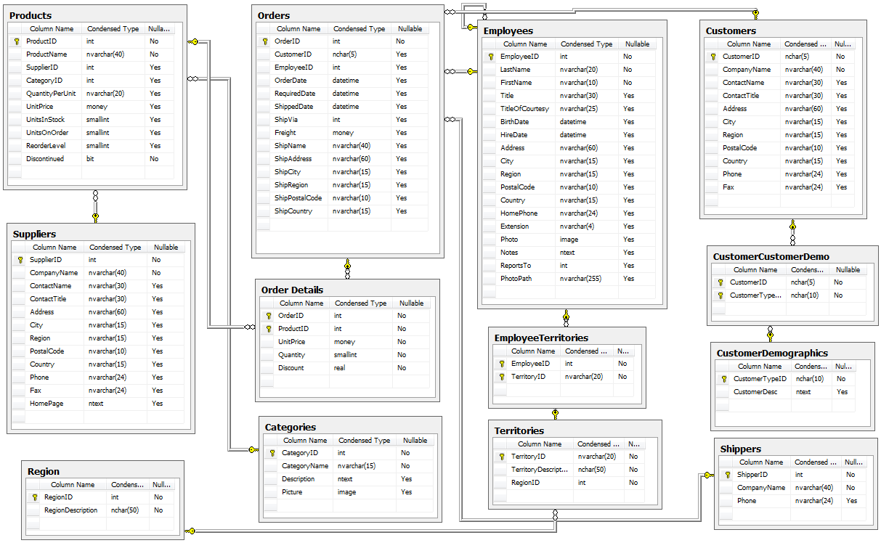
Project analysis slide 2
Goal
Uncover details that affect sales
Draw conclusions that will generate more profit

Slide 3
Project analysis slide 4
Approach
Conduct experiment
Gather Historical Data
Conduct experiment
Draw conclusions
Implementation
Customer Objectives
Conduct experiment

Slide 4
Project analysis slide 3
Experiment
Observation
Research
Hypothesis
Experiment
Conclusion
Historically, has this been a factor? How about for other companies?
What do we think the outcome is going to be?
What should we test?
Is the hypothesis true? More importantly, will it always be true?
What changes can we make? Will it increase revenue?

Slide 5
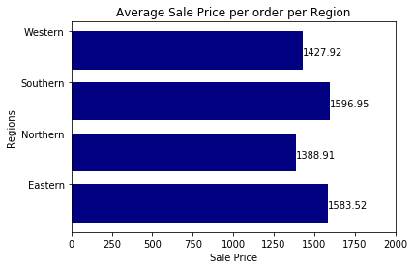
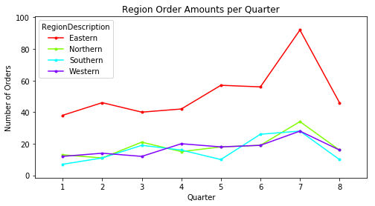
Project analysis slide 5
Findings
Discounted products = Higher quantity of sales BUT higher discount ≠ higher quantity of sales
Eastern Region is generating the most sales every quarter
All product prices increase April 5th, 2013 but it had no effect on quantity of sales

Slide 6
Thank You

